Slide 1

SUPERSTORE DATA ANALYSIS
Submitted By-SUJINOVEN.J

Slide 2
About Superstore Dataset
Context
With growing demands and cut-throat competitions in the market, a Superstore Giant is seeking your knowledge in understanding what works best for them. They would like to understand which products, regions, categories and customer segments they should target or avoid.
Data Set URL:
https://www.kaggle.com/datasets/vivek468/superstore-dataset-final
Business Questions:
1.Which Category Generates the Highest Sales?
2.Which categories are profitable?
3.Which regions generate maximum revenue?
4.Top 10 States by Sales
5.Which Customer Segment Generates Maximum Revenue?
6.Top 10 Products by Sales
7.Key Insight

Slide 3
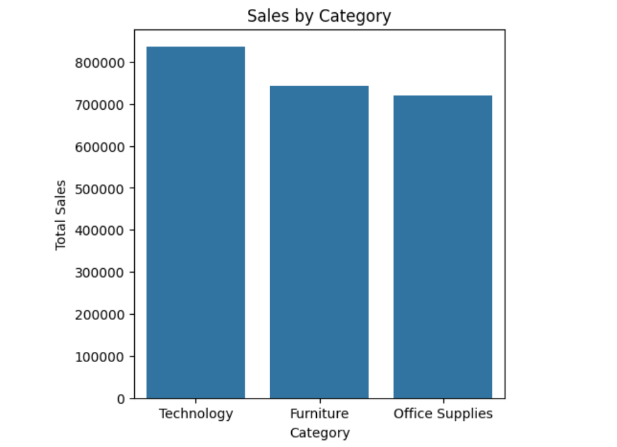
1. Which Category Generates the Highest Sales?
Category
Technology 836154.03
Furniture 741999.80
Office Supplies 719047.03
Among all categories, Technology achieved the highest sales, Furniture ranked second, and Office Supplies ranked third.

Slide 4
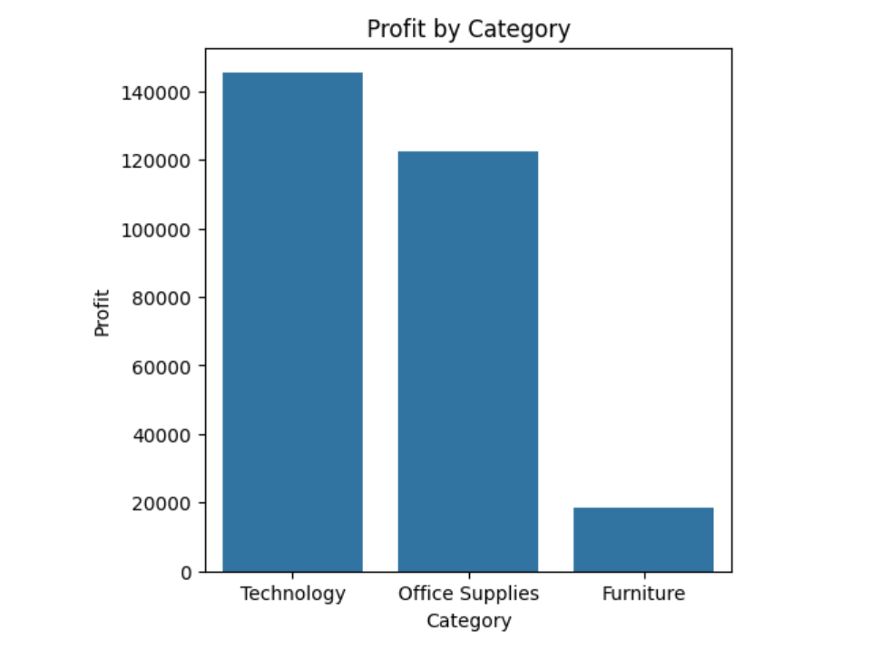
2. Which Category Generates the Highest Profit?
The Technology category generated the highest profit, followed by Furniture, while Office Supplies contributed the least. This trend highlights that higher sales within a category are directly associated with higher profit.
Insight
Since Technology generates maximum profit:
1. Increase marketing for Technology products.
2. Expand inventory.
3.Launch premium product bundles.

Slide 5
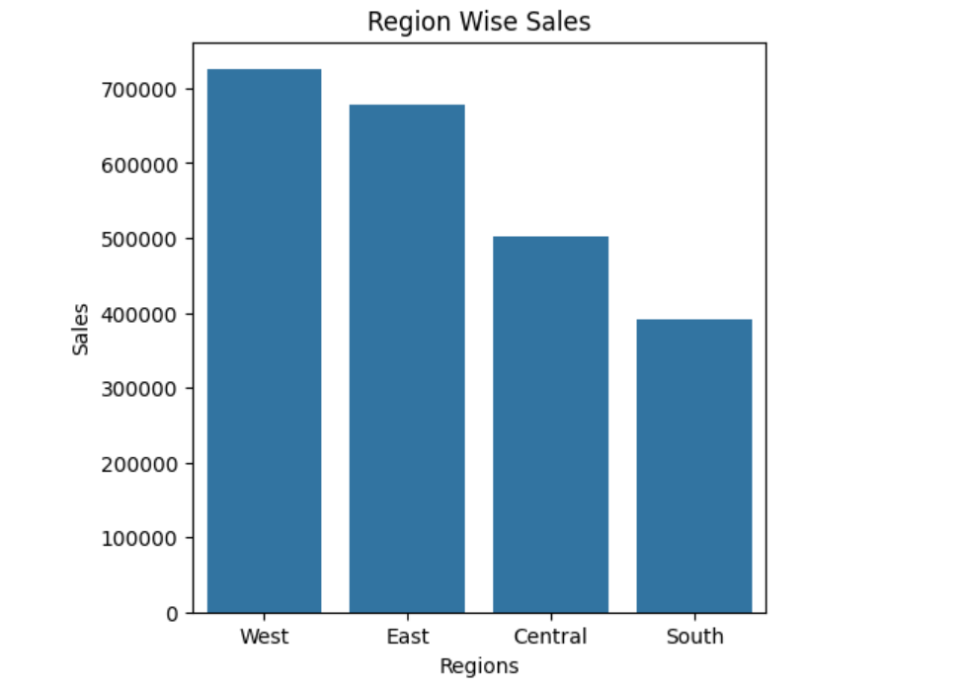
3. Which Region Has the Highest Sales?
The West region achieved the highest sales, followed by the East, while the Central and South regions recorded comparatively lower figures. This pattern highlights the observation that higher sales in a region are directly linked to higher profit generation.

Slide 6
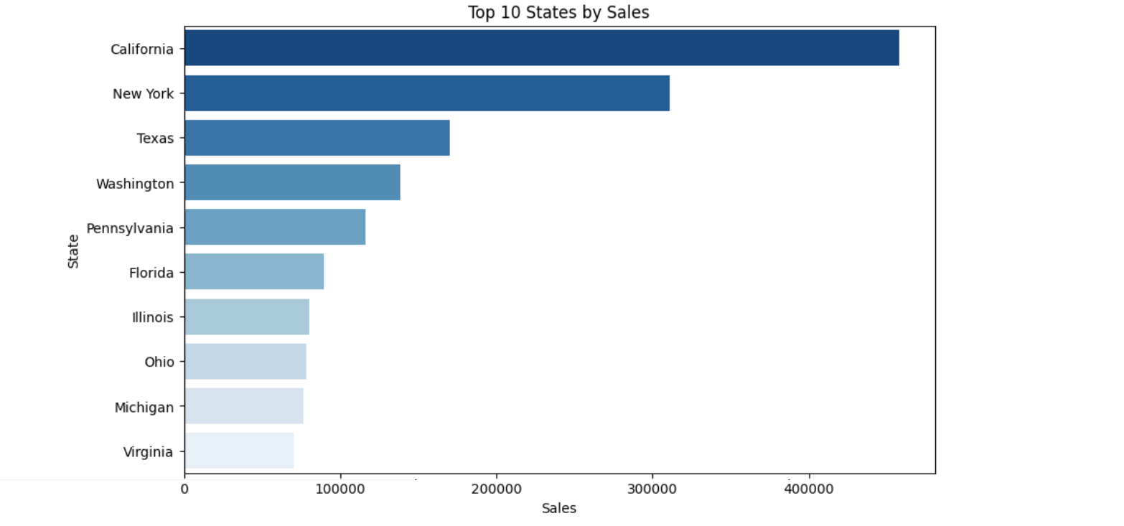
4. Top 10 States by Sales
California recorded the highest sales, followed by New York and Texas, while states such as Virginia, Michigan, and Ohio contributed comparatively lower figures. This distribution underscores the principle that higher sales in a state are directly associated with higher profit.
Insights:
Since California and New York are highly profitable:
1.Increase Advertising budget there
2. Open Additional Distribution Centers
3.Improve customer retention programs

Slide 7
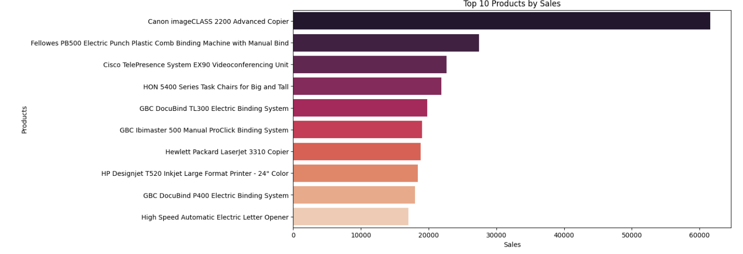
5. Top 10 Products by Sales
The Canon imageCLASS 2200 Advanced Copier leads all products in sales, followed by the Fellowes PB500 Electric Punch Plastic Comb Binding Machine and the Cisco TelePresence System EX90 Videoconferencing Unit. Overall, the data reveals that office equipment and technology‑related products dominate sales performance, reinforcing the trend that higher sales volumes correspond to higher profitability.

Slide 8
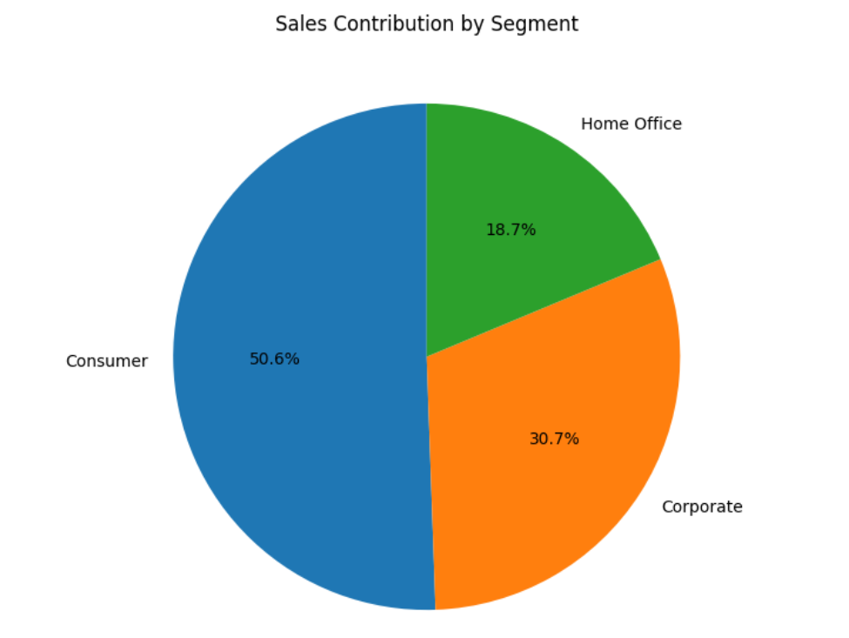
6..Which Customer Segment Generates Maximum Revenue?
The Consumer segment accounts for the largest share of sales at 50.6%, followed by Corporate with 30.7%, and Home Office with 18.7%. This distribution reinforces the principle that higher sales in a segment are directly associated with higher profit generation.

Slide 9
KEY INSIGHTS
Focus on profitable categories such as Technology.
Increase investment in profitable states such as California and New York.
Retain high-value customers through loyalty and reward programs.

